Slide 1
Year 10 Science Daily Review Slides

Slide 2
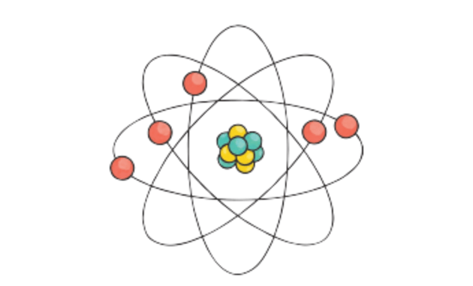
Repeat the opposite word/phrase.
ATOM
THE SMALLEST PARTICLE OF A CHEMICAL ELEMENT THAT CAN EXIST.

Slide 3
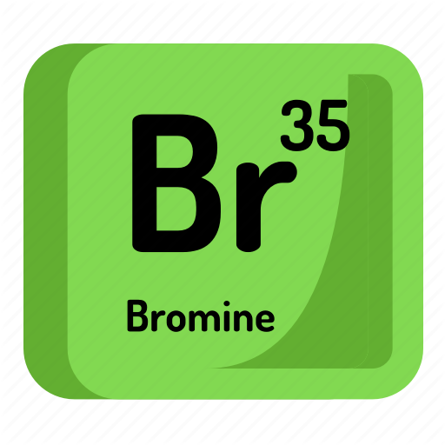
Repeat the opposite word/phrase.
ELEMENT
A SUBSTANCE THAT CONTAINS ONLY ONE TYPE OF ATOM

Slide 4
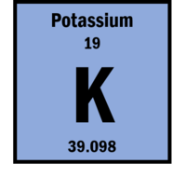
Repeat the opposite word/phrase.
ATOMIC NUMBER
THE NUMBER OF PROTONS IN AN ATOM

Slide 5
Repeat the opposite word/phrase.
MASS NUMBER
THE NUMBER OF PROTONS AND NEUTRONS IN AN ATOM

Slide 6
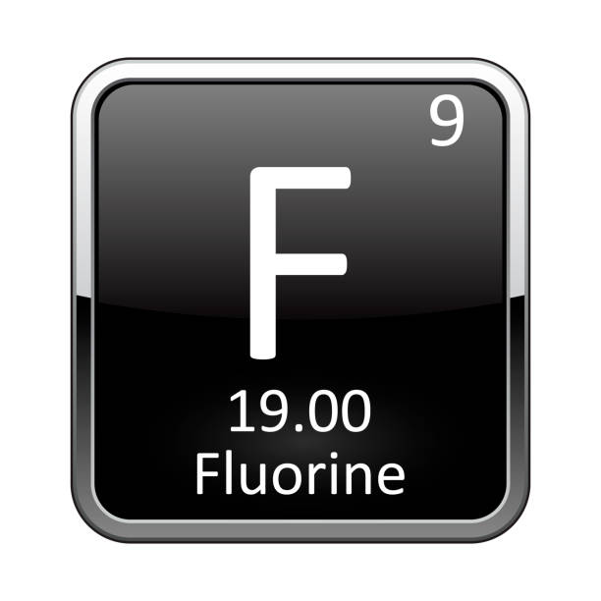
CALCULATING NEUTRONS

Slide 7
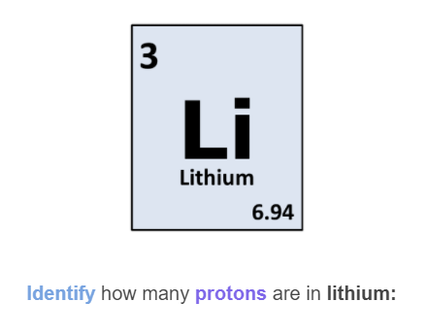

Slide 8
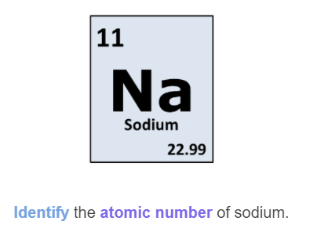

Slide 9
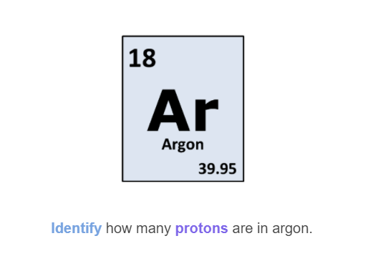

Slide 10
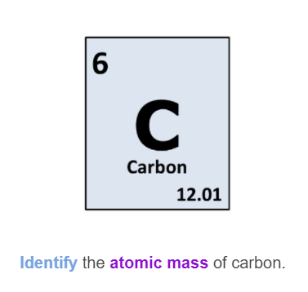

Slide 11
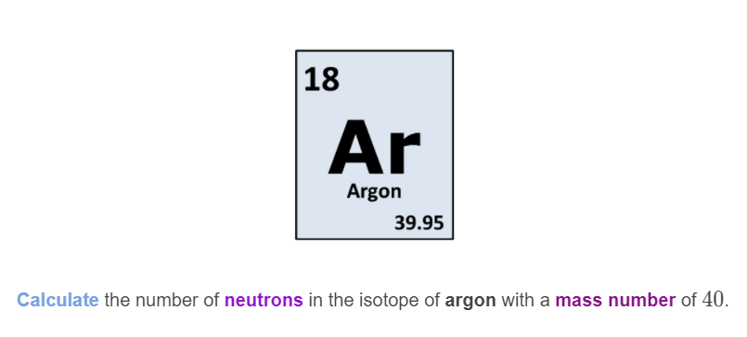

Slide 12
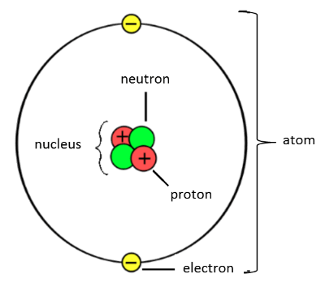
Protons and Neutrons make up the nucleus, which is at the centre of the atom.
Electrons are found in orbitals (or shells) around the outside of the nucleus

Slide 13
Protons are positively charged (+1)
Electrons are negatively charged (-1)
Neutrons have no charge (0)

Slide 14
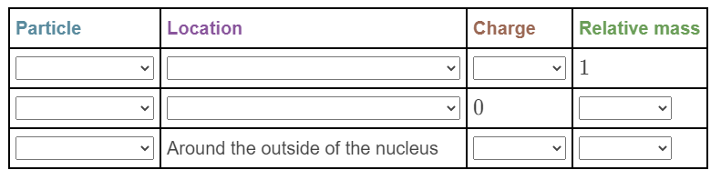

Slide 15
Repeat the opposite word/phrase.
ELECTRON CONFIGURATION
SHOWS THE LOCATION OF ALL ELECTRONS IN AN ATOM

Slide 16
The first electron shell can hold up to 2 electrons
The second electron shell can hold up to 8 electrons
The third electron shell can hold up to 8 electrons

Slide 17
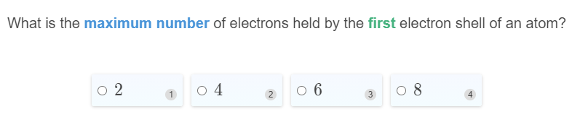

Slide 18
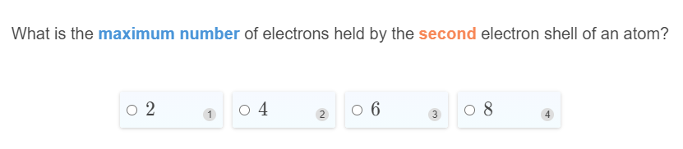

Slide 19
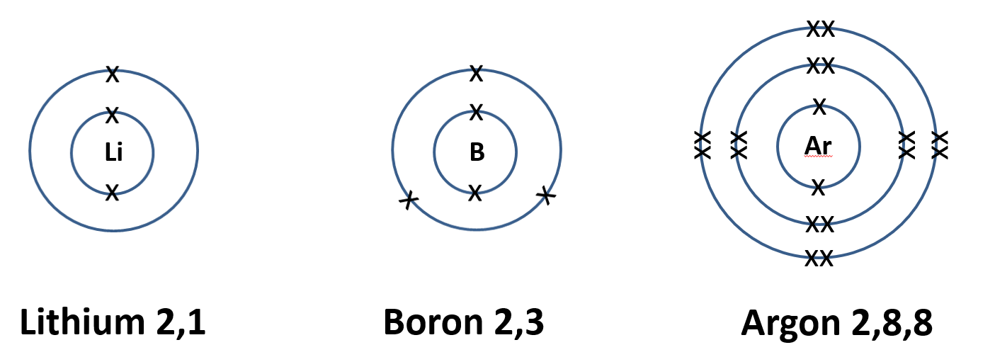

Slide 20
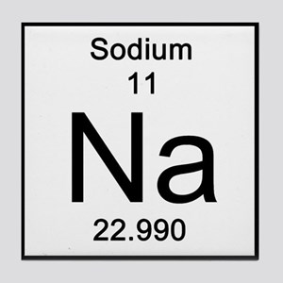
On your whiteboards.
Draw electrons shell diagrams and write electronic structures for:
Sodium
x
xx
x
xx
Na
xx
x
xx
2,8,1

Slide 21
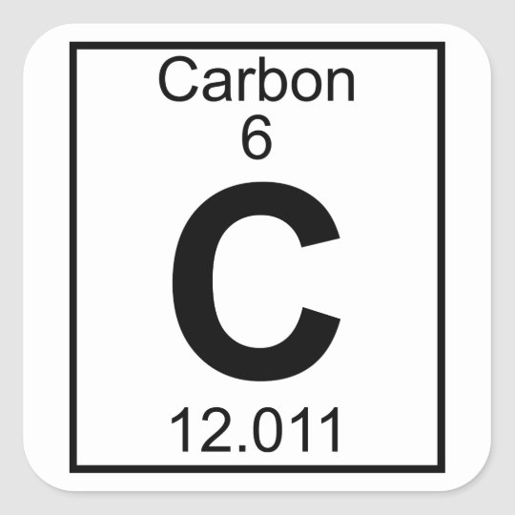
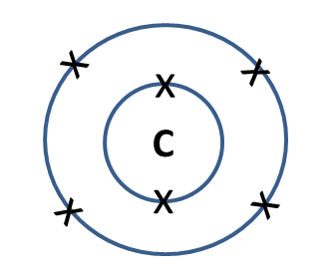
On your whiteboards.
Draw electron shell diagrams and write electronic structures for:
Carbon
2,4

Slide 22
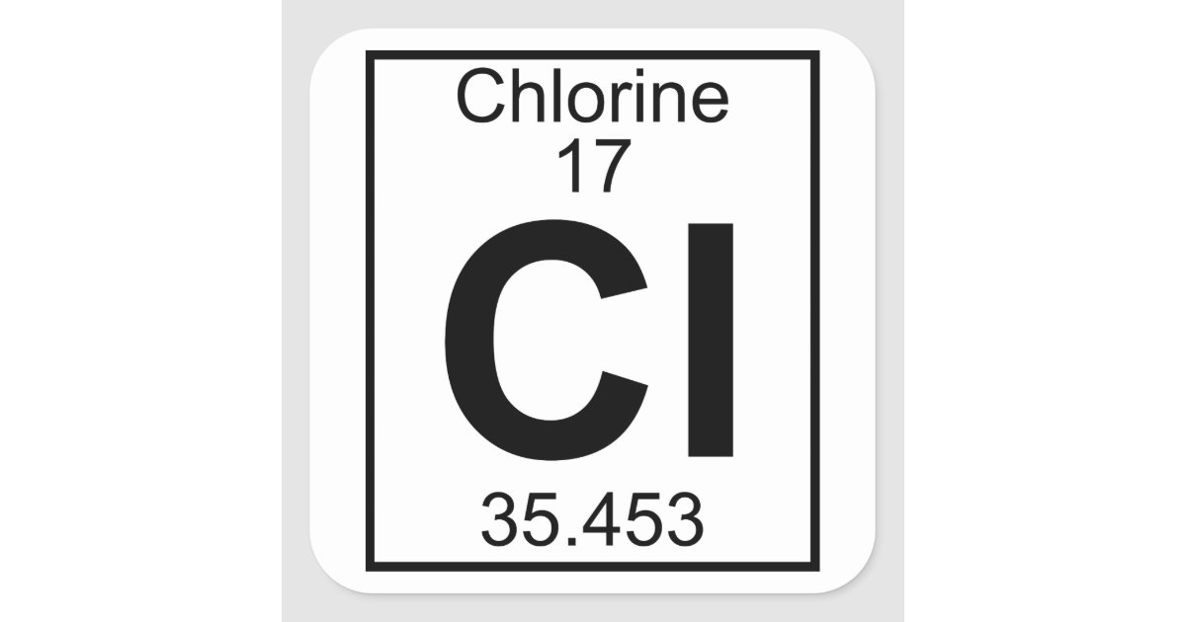
On your whiteboards.
Draw electron shell diagrams and write electronic structures for:
Chlorine
x
xx
x
xx
xx
Cl
xx
xx
x
xx
xx
2,8,7

Slide 23
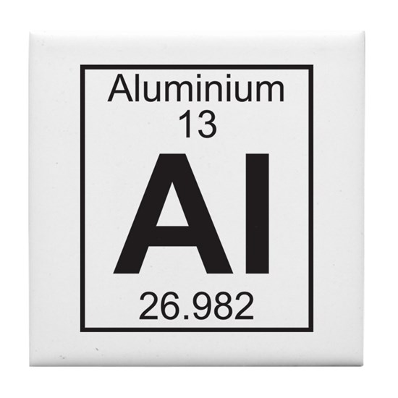
On your whiteboards.
Draw electron shell diagrams and write electronic structures for:
Aluminium
xx
x
x
xx
Al
xx
x
x
xx
x
2,8,3

Slide 24
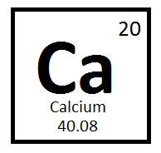
On your whiteboards.
Draw electron shell diagrams and write electronic structures for:
Calcium
xx
xx
x
x
xx
xx
Ca
xx
xx
x
x
xx
xx
2,8,8,2

Slide 25
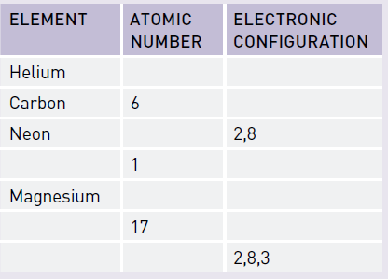
On your whiteboards.

Slide 26
Repeat the opposite word/phrase.
ION
CHARGED PARTICLES THAT FORM WHEN AN ATOM LOSES OR GAINS ELECTRONS.

Slide 27
Repeat the opposite word/phrase.
IONS FORM BECAUSE:
ATOMS ARE MOST STABLE WITH A FULL OUTER ELECTRON SHELL.

Slide 28
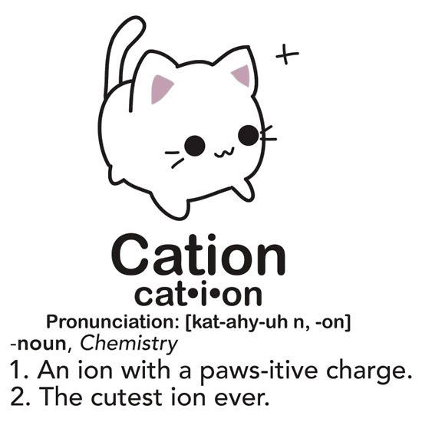
Repeat the opposite word/phrase.
CATIONS
AN ATOM THAT HAS LOST ELECTRONS

Slide 29
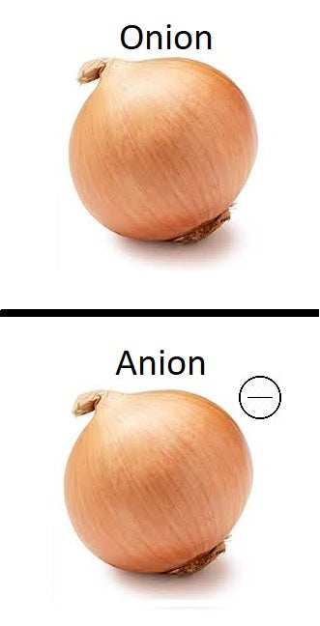
Repeat the opposite word/phrase.
ANIONS
AN ATOM THAT HAS GAINED ELECTRONS

Slide 30
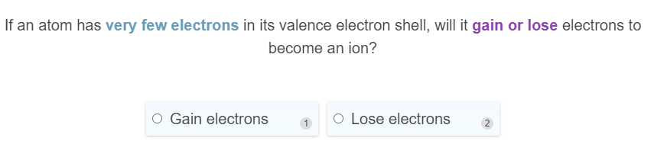
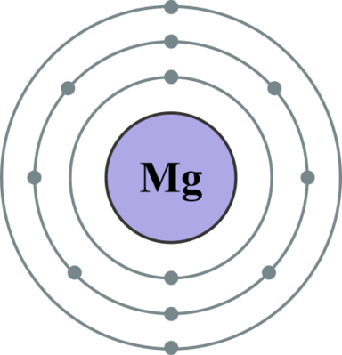
On your whiteboards.

Slide 31
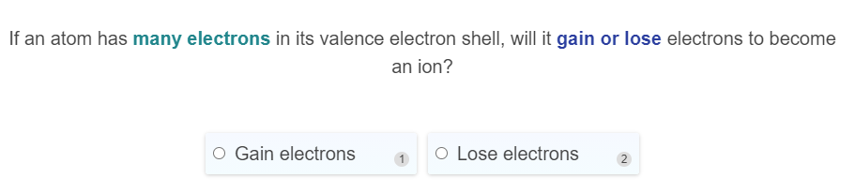
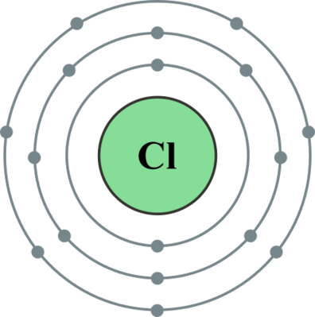
On your whiteboards.

Slide 32
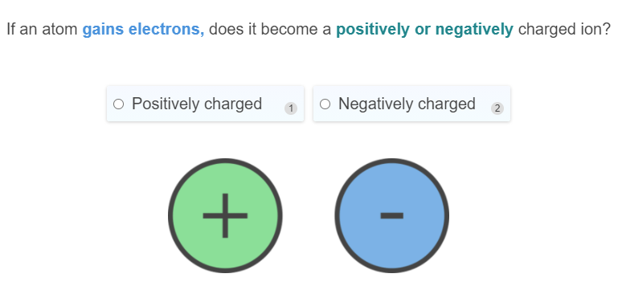
On your whiteboards.

Slide 33
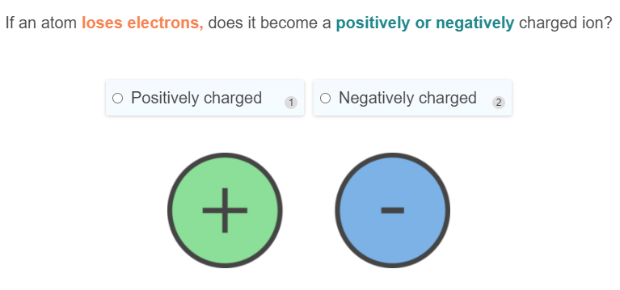
On your whiteboards.

Slide 34
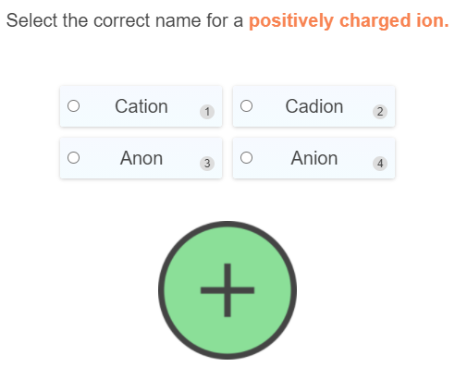
On your whiteboards.

Slide 35
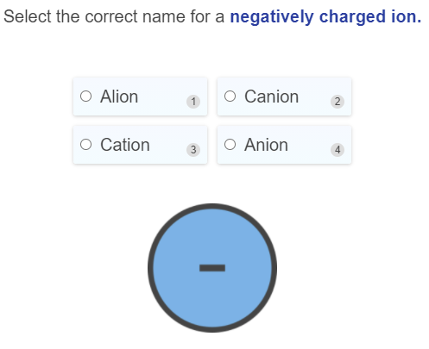
On your whiteboards.

Slide 36
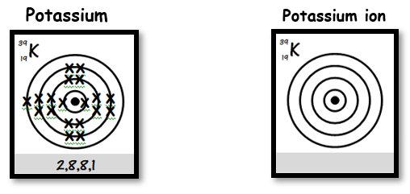
On your whiteboards.
Draw the electron configuration for:

Slide 37
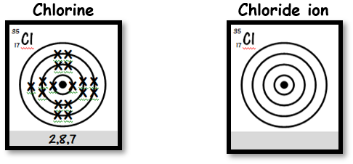
On your whiteboards.
Draw the electron configuration for:

Slide 38
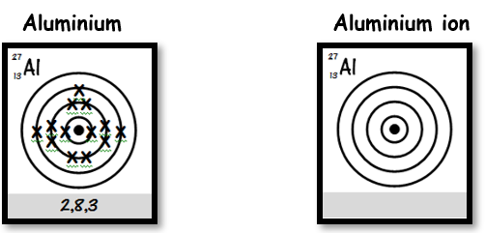
On your whiteboards.
Draw the electron configuration for:

Slide 39
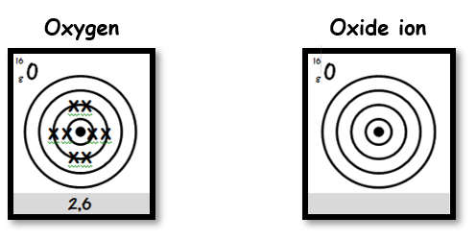
On your whiteboards.
Draw the electron configuration for:

Slide 40
Repeat the opposite word/phrase.
THE PERIODIC TABLE
SHOWS US ALL KNOWN ELEMENTS.

Slide 41
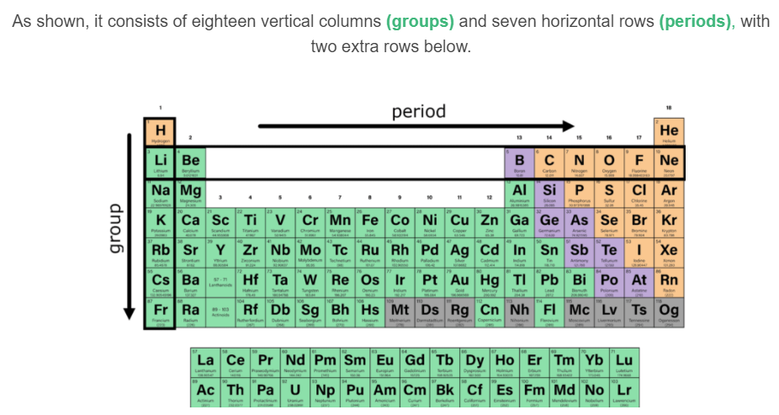

Slide 42
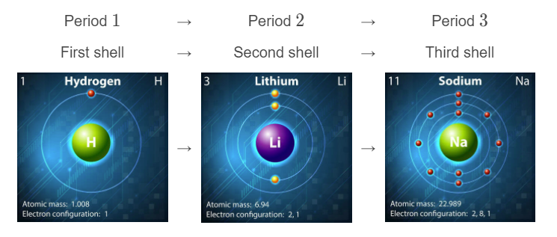
Each period (row) represents another electron shell being filled.

Slide 43
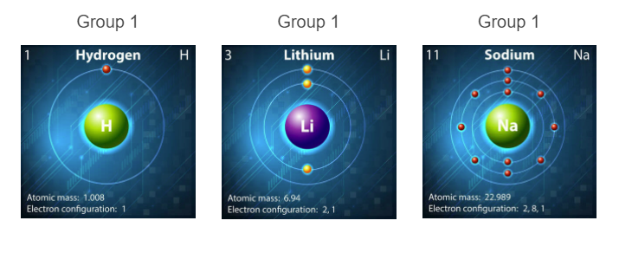
Each group contains the elements with the same number of valence electrons

Slide 44
Elements are grouped by number of valence electrons because these are the electrons involved with bonding.
They dictate the properties of an element.
E.g. Group 18 – The Noble Gases

Slide 45
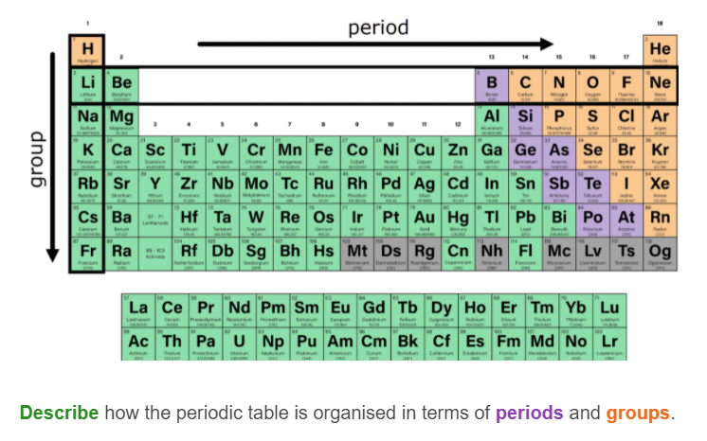

Slide 46
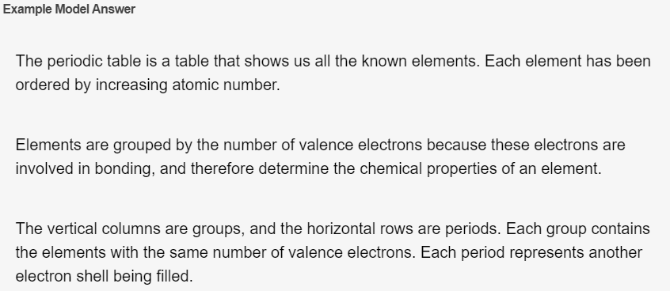

Slide 47
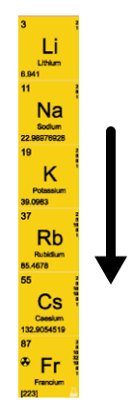
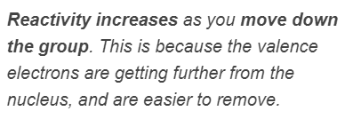
Group 1 Elements are the Alkali Metals.
They are highly reactive due to having 1 valence electron.
They form ions with a charge of +1

Slide 48
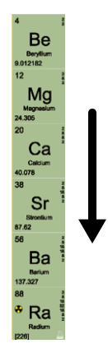
Group 2 Elements are the Alkaline Earth Metals.
They are very reactive due to having 2 valence electrons.
They form ions with a charge of +2

Slide 49

Group 14
They have 4 valence electrons
They tend to share electrons with other non-metals to bond

Slide 50
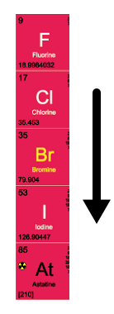
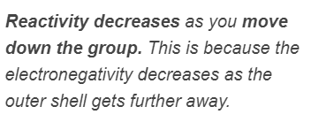
Group 17 are the Halogens
Halogens are quite reactive. They have 7 valence electrons.

Slide 51
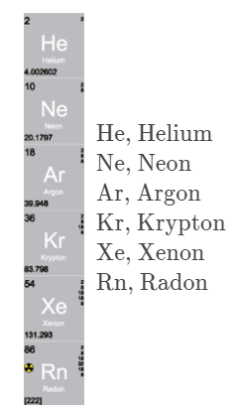
Group 18 are the Noble Gases
They are all colourless and occur naturally in our atmosphere (except for radon) They have a full outer shell and do not need to fulfil the octet rule.

